Slide 1
Progress Tag
Name: Mohammed Yasin
Roll: BSSE 1406
Name: A. M Samdani Mozumder
Roll: BSSE 1412
Course: Web Technology

Slide 2
Table of Contents
01. Introduction
02. Working Methodology
03. Code
04. Backward Compatibility

Slide 3
Introduction
1

Slide 4
Introduction
The <progress> HTML tag represents a completion level for a task, typically shown as a filled bar. This tag is generally paired with a value attribute (for the current progress) and a max attribute (for the target or total amount).

Slide 5
Working Methodology
2

Slide 6
Working Methodology
The <progress> element works by setting two attributes:
value: Specifies the current progress. This is a numeric value, such as the current percent completed (e.g., 50 for 50%).
max: Specifies the target amount to reach. The browser interprets value relative to max to show how full the bar should be.
For example, if value is 50 and max is 100, the progress bar will be half-full.

Slide 7
Code
3

Slide 8
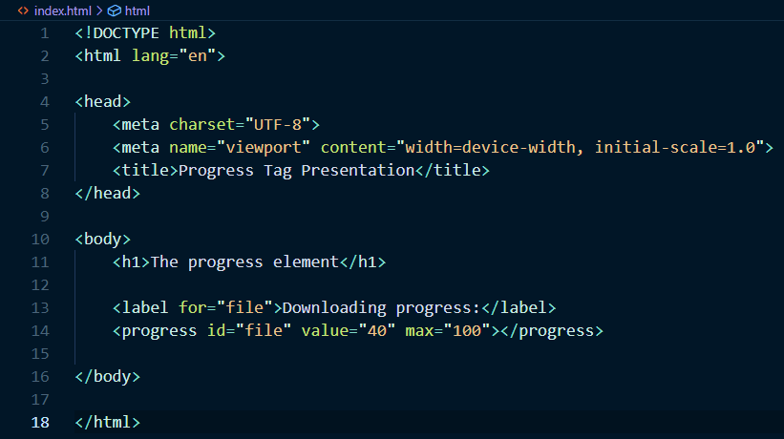
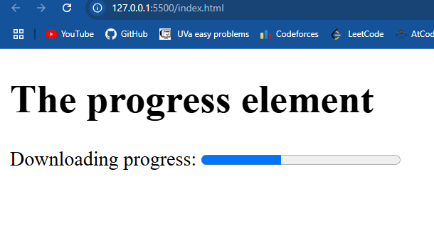
Code

Slide 9
Backward Compatibility
4

Slide 10
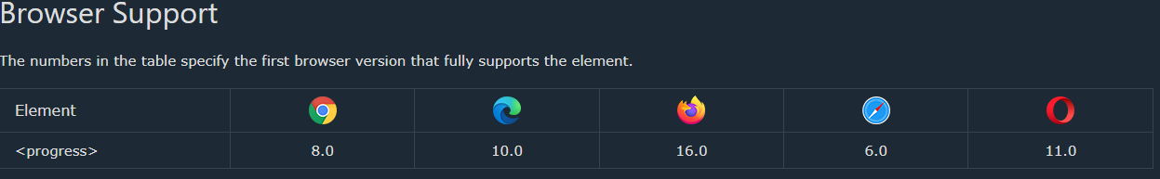
Backward Compatibility
The <progress> element is supported by most modern browsers:
Chrome
Firefox
Edge
Safari
However, it may not display correctly in older versions of Internet Explorer (pre-IE 10) or some older mobile browsers

Slide 11
Thank You

